Slide 1
Parallel Game Engine Design
or How I Learned to Stop Worrying and Love Multithreading

Slide 2
Preliminaries
The GGE and serial architectures
Multithreading design decisions
The new engine
Q/A

Slide 3
GGE
The Gamepipe Game Engine is a student built game engine using the Ogre3d rendering engine for underlying scene management and basic rendering
Ogre has support for basic multithreading, mostly limited to the background loading of resources

Slide 4
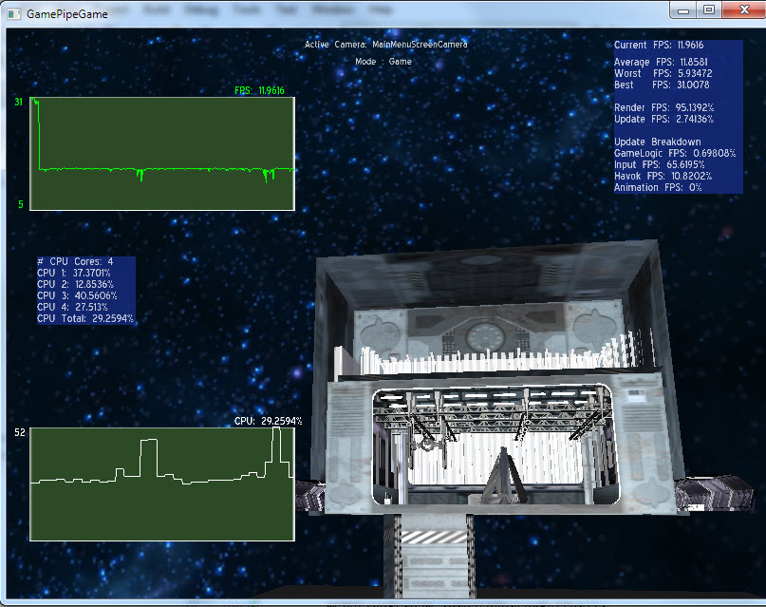
GGE continued
Last semester, Steve Wenzke and I explored multithreading the GGE and were able to implement a dedicated rendering thread and limited multithreading of some higher level systems

Slide 5
Limitations to multithreading GGE
Inconsistent and interrelated update calls for systems/game objects make separating independent tasks difficult
Lack of a common interface for events/manipulations of scene objects like updating position
No “owner” for the scene Ogre maintains; systems access and manipulate it at will.

Slide 6
Starting from scratch
This semester I decided to start from scratch on a new engine that would scale with an arbitrary number of threads.
Once the underlying design was pinned down, I started to port existing functionality from the GGE to the new engine with modifications owing to the new design

Slide 7
Multithreading Design Decisions
Shared resources
  What is shared? When? Is that a problem? Sometimes; sometimes not.
Synchronization
  Locks and/or semaphores? Something more elegant?
Scalability
  Can the architecture utilize 4 cores as well as it can 40?

Slide 8
Shared resources – Game Objects
Universal
AI
Animation
Physics
Graphics
Position
Orientation
Scale
AgentState
PathNode
…
Position
Orientation
Scale
AnimFrame
BoneList
…
Position
Orientation
Scale
RigidBody
Mass
…
Position
Orientation
Scale
SceneNode
Entity
…

Slide 9
Synchronization
Physics
Graphics
StateChange
Position
Orientation
Scale
RigidBody
Mass
…
StateManager
Position
Orientation
Scale
SceneNode
Entity
…
StateChange
StateChange
StateChange

Slide 10
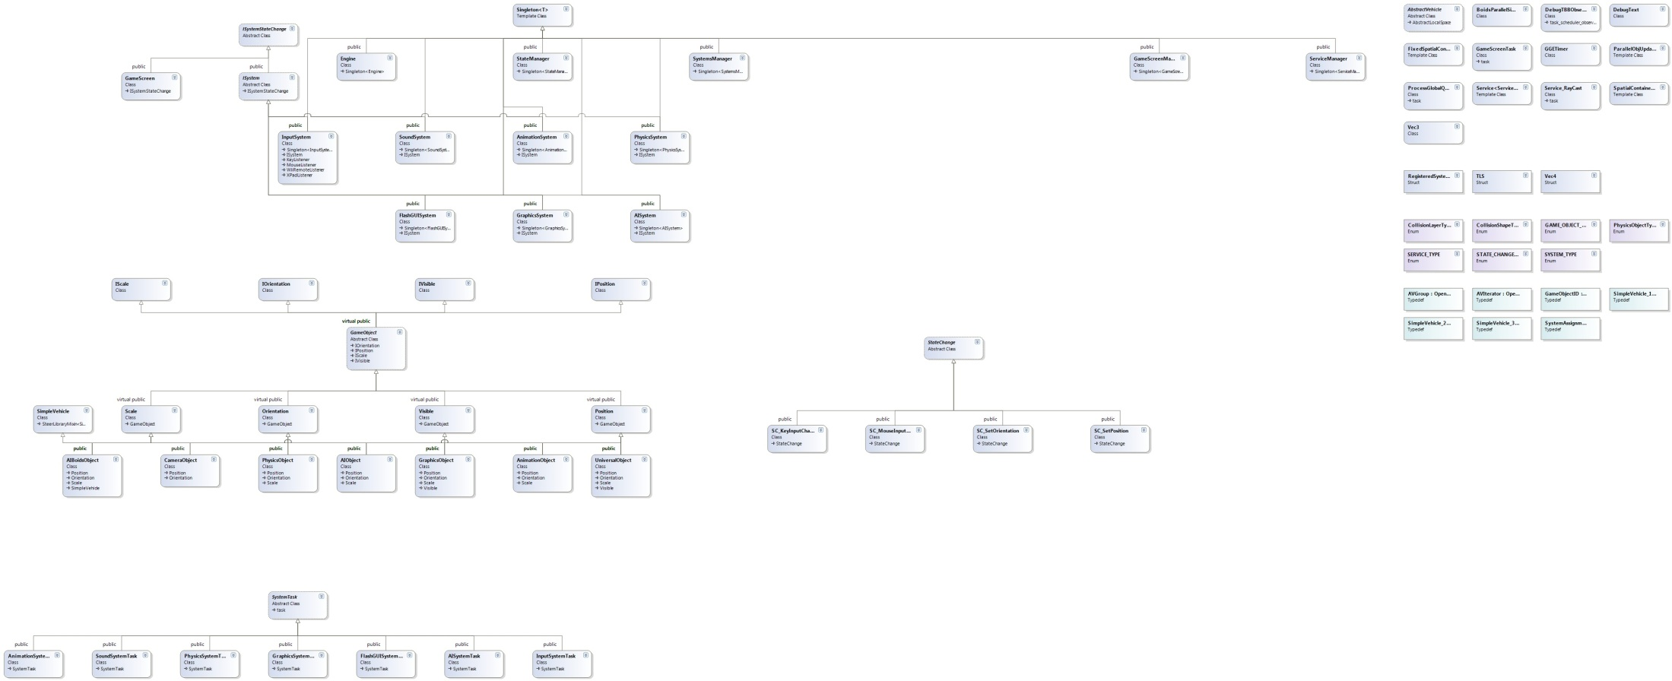
Synchronization

Slide 11
Engine Update Loop
Propagate and Process
State Changes
Main Update
Gather State Changes

Slide 12
Main Update
TBB Scheduler
AI System
Animation
System
Physics
System
Graphics
System
Process State Changes
Process State Changes
Process State Changes
Process State Changes
Update
Update
Update
Update
Gather State Changes
Gather State Changes
Gather State Changes
Gather State Changes

Slide 13
Demo
Stats
  3300+ GameObjects (2300 Physics objects, 1000 AI objects)
  Average fps on 4-core/8-thread i7 920 = 35-55 fps
  90% + cpu utilization across all physical/hyper threads

Slide 14
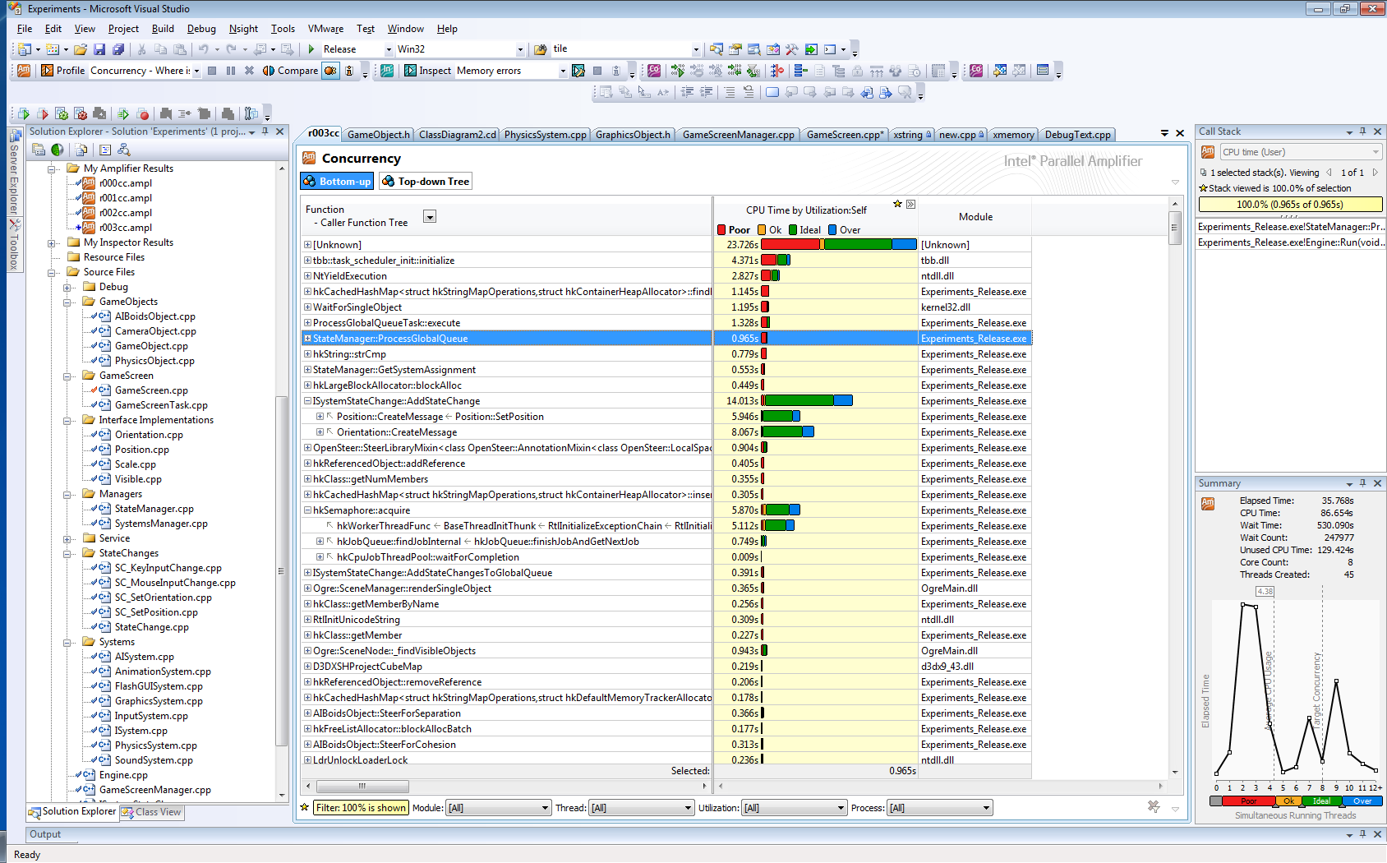

Slide 15
Example – Parallel Boids Simulation
Based on Opensteer library’s flocking simulation
Problems for parallelization
  Race condition on each AIObject’s updated position
  Highly contended shared resource

Slide 16
Example – Parallel Boids Simulation
Solution
  Separate the Simulation and Updates of local information to two different steps, each run in parallel with a natural barrier in between
  Create a concurrent, spatial data structure to maintain neighbor lists every frame
    “FixedSpatialContainer” maintains two 3d arrays of tbb::concurrent_vectors that allow for completely parallel access and updates to spatial information used in the simulation

Slide 17
Video
https://gpserver01.usc.edu/svn/gge/ogreaddons/IntelTBBUpgrade/presentation_video/presentation.mp4

Slide 18
The future
Short term plans
  Port over the FlashGUI and FMOD Audio functionality from the GGE
  Port over the dotScene parser for scene loading
Longer term
  Port the animation and remainder of the physics functionality from the GGE
  Further performance improvements
    Explore complete free step mode between systems

Slide 19
Q/A

